Slide 1

Machine learning models to optimize merchandising of H&M Store​
Presented By,
Sakshi Jain
Sakshi Tongia
Vaibhav Yalla
Lakshmi Naga Meghana Polisetty

Slide 2





Project Background
Industry Overview | Tremendous Variety​ Highly dynamic​ Competitive ​ Rapidly emerging​ Depends on the geographical location of the store​
Problem Definition | Well informed Customers​ Inventory Prediction difficult​ The right product at the right time is a challenge​ Less customer loyalty
Objectives | Product Demand forecasting​ Customer RFM profiling​ Customer Lifetime profiling​ Churn Rate
Motivation | Improve product assortment​ Anticipate demand correctly​ Increase the customer lifetime value​ Gain new customers​ Improve customer retention​ Forecast demand and sales

Slide 3



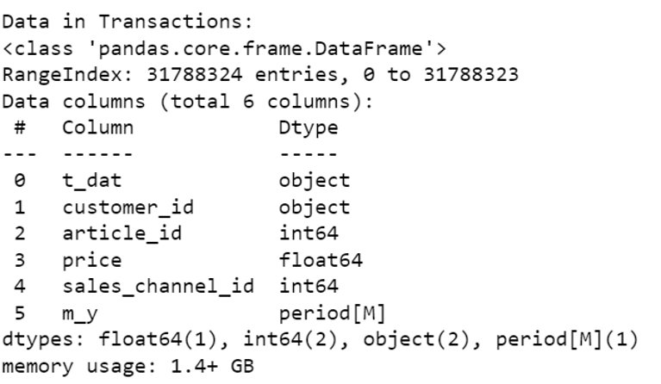
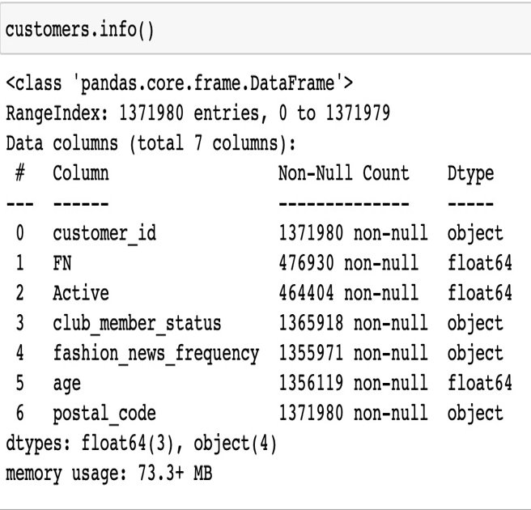
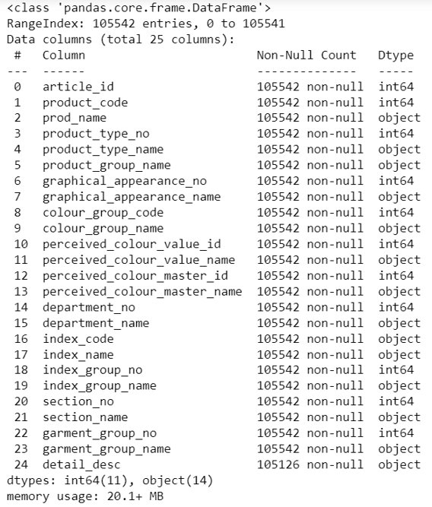



Executive Summary
Optimizing merchandise of H&M sales
Articles : 0.1M rows, 25 columns
Transactions : 31M rows, 6 columns
Customer : 1.3M rows, 7 columns
Purchase history of 13,71,980 customers across time span of 2 years
Data Sourcing
Collecting data from H&M Merchandising sales data
Non-Linear and Imbalanced Data
Data Cleaning
Handling missing values, outliers, reformatting and resampling data
Feature Extraction
Model Development
Performance Comparison
Performance Comparison

Slide 4

Literature Survey
Paper Title, Author and Publication | Objective | Methodology Used | Result

Slide 5

Project Management

Slide 6

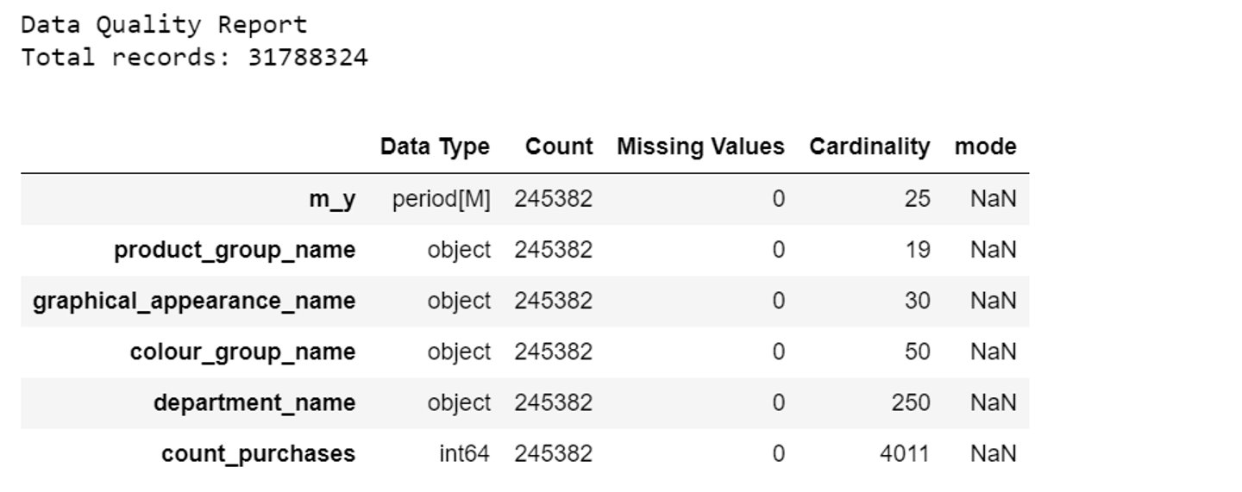
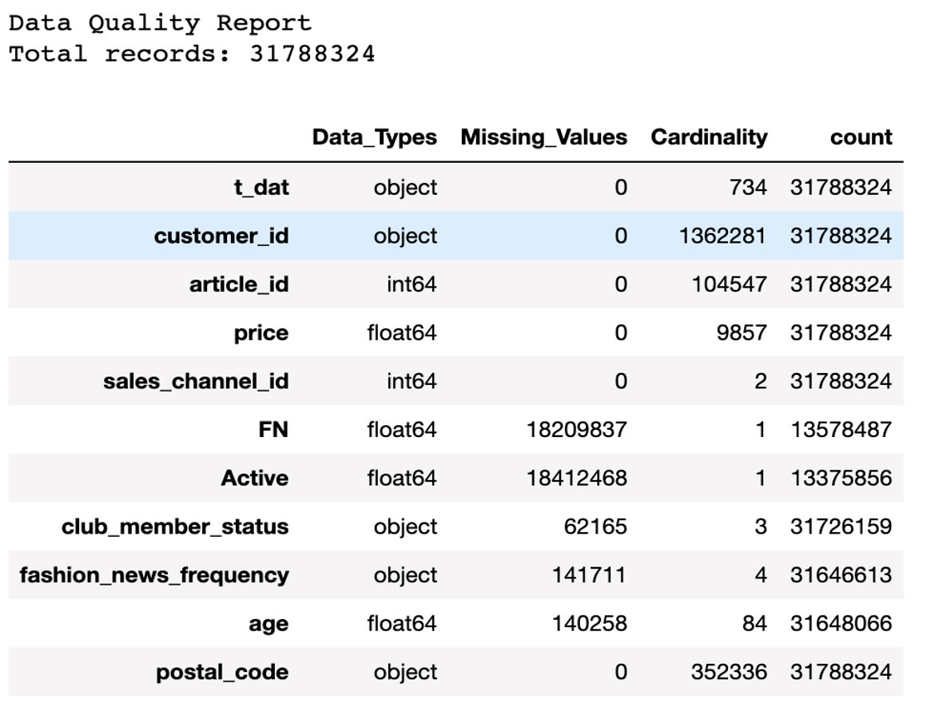
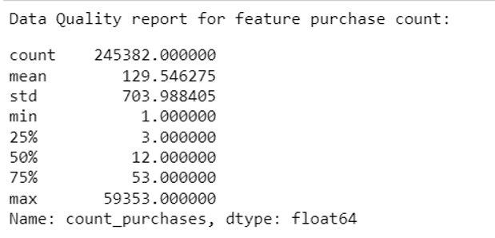
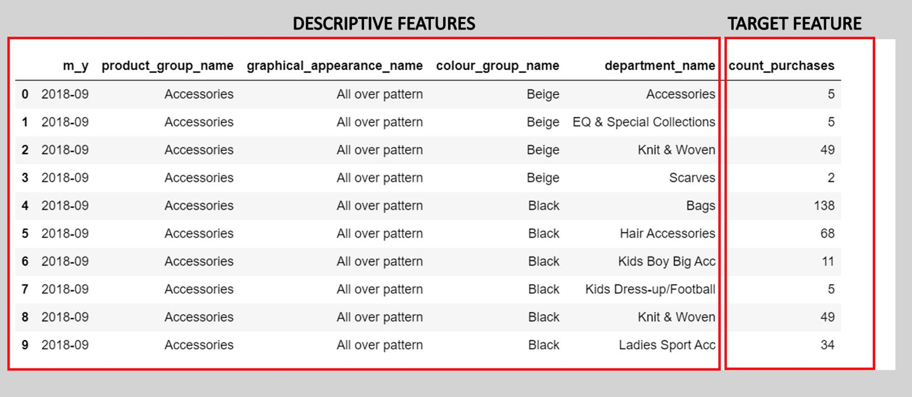
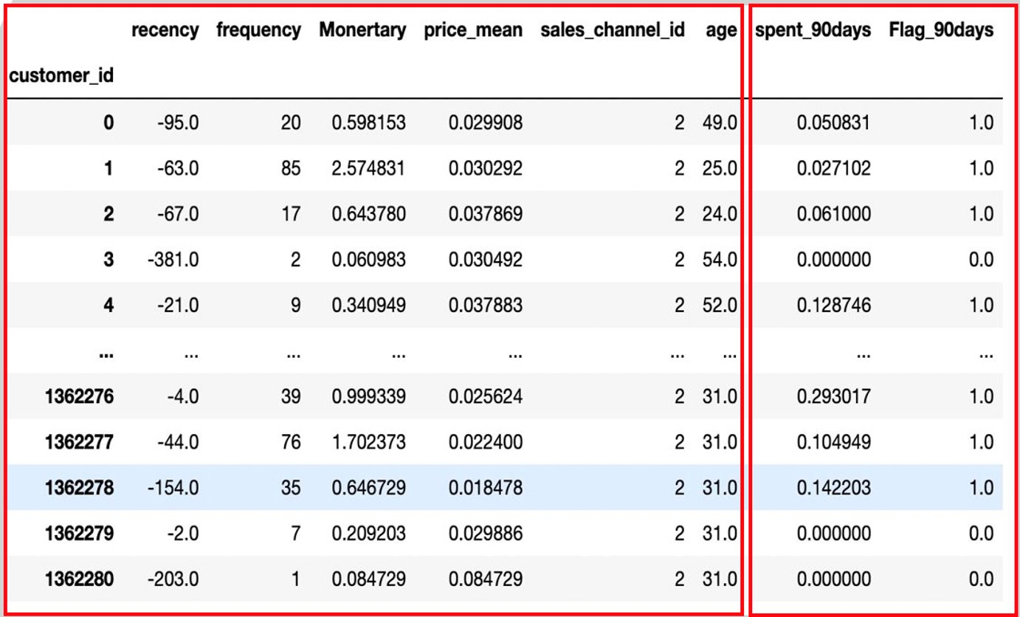
Data Collection
Data Quality Report
Analytics Base Table

Slide 7

Data Pre-Processing (for customer)
Removing Missing Values
Outlier Handling
Data Reformatting
Club member status, Fashion news frequency columns were imputed with values NONE since less than 50% of the data was missing.
FN and Active features were removed from the data since more than 60% data was missing
Age has 23% of missing value, hence imputed with mean value
T_dat is representing date column, but the datatype was object, hence converted into datetime datatype.
Label Encoding
Dimensionality Reduction
Customer IDS are in the form of alphanumeric, hence converted the data in numerical form.
Feature Selection

Slide 8
Data Pre-Processing (for overall sales)
Removing Missing Values
Outlier Handling
Data Reformatting
Club member status, Fashion news frequency columns were imputed with values NONE since less than 50% of the data was missing.
FN and Active features were removed from the data since more than 60% data was missing
Age has 23% of missing value, hence imputed with mean value
T_dat is representing date column, but the datatype was object, hence converted into datetime datatype.
Label Encoding
Dimensionality Reduction
Customer IDS are in the form of alphanumeric, hence converted the data in numerical form.
Feature Selection

Slide 9

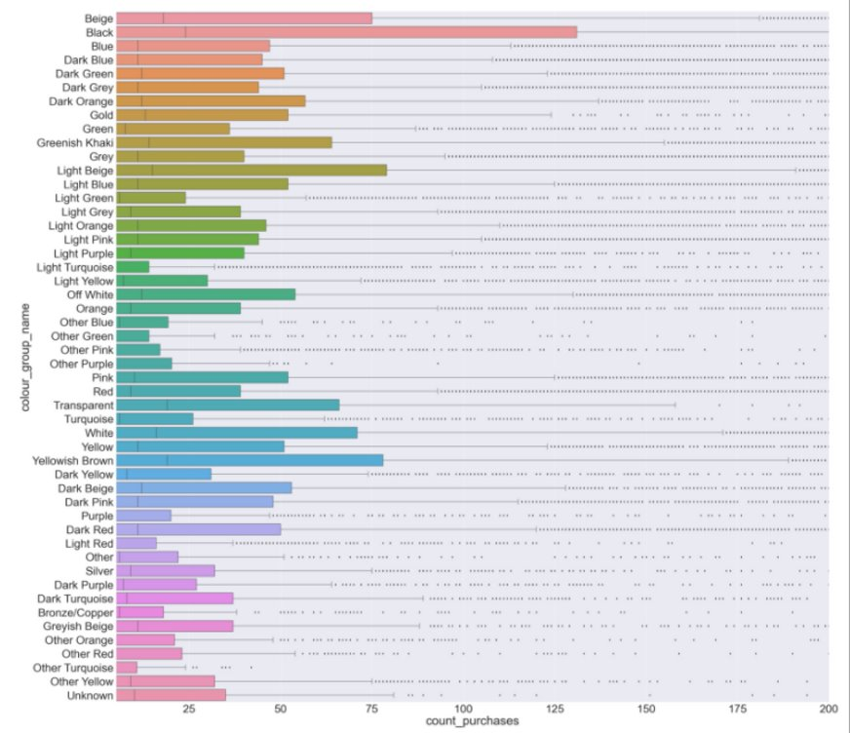
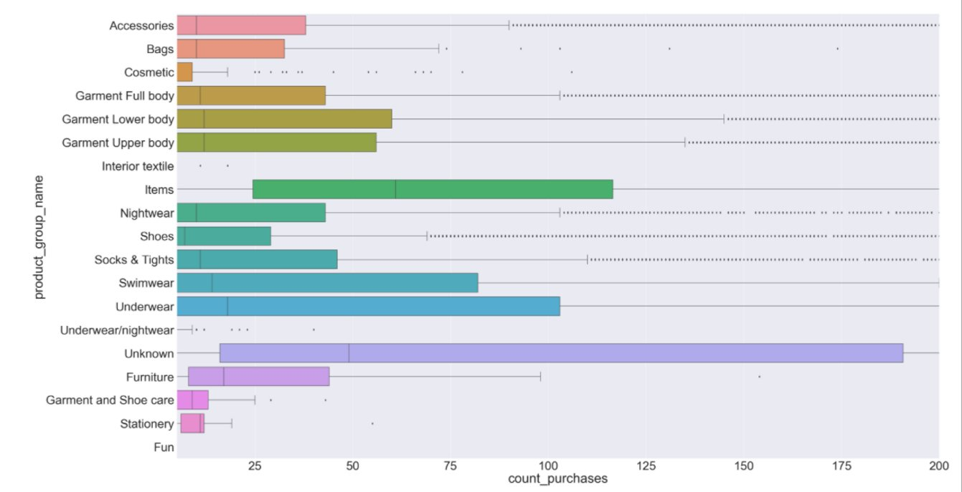
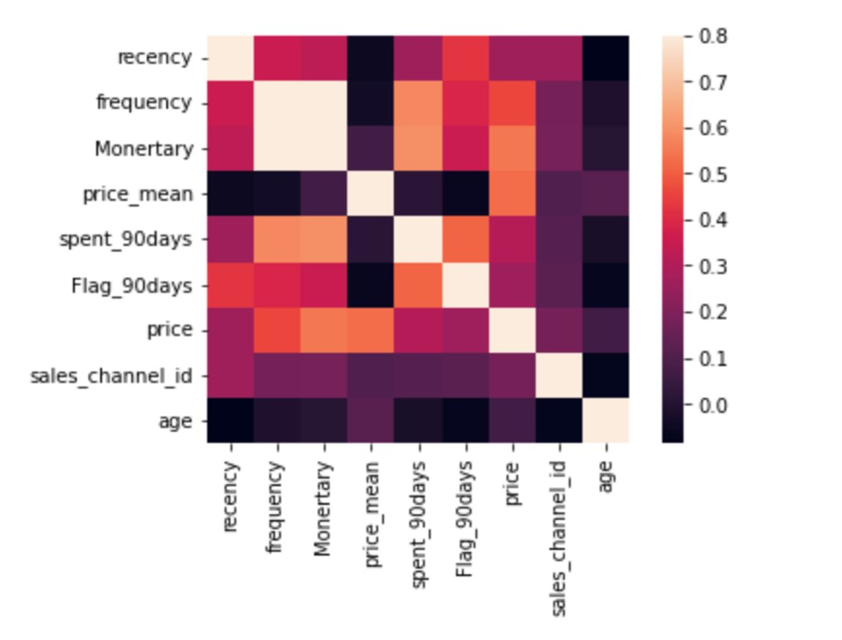



Exploratory Data Analysis
Descriptive Vs Target Features
Correlation Matrix
Derived Attributes – RFM (Recency, Frequency, Monetary)​
How often does the customer make a purchase in certain period of time?​
How often does the customer make a purchase in certain period of time?​
How much total transaction amount does the customer spend?​
RECENCY = MAX DATE – LAST PURCHASE DATE OF THE CUSTOMER​
MONETARY = SUM (TRANSACTIONS) OF EACH CUSTOMERS​
TOTAL COUNT OF TRAN BY EACH CUSTOMER

Slide 10

Data Transformation (for customer)
Normalization
Handling Skewness
Dimensionality Reduction
Most features were not normally distributed,
Scaled the features within range of zero to one using Min Max Scaler.
The number of features were reduced to 2 for providing better understanding on the scatter plot.
Used Principal Component Analysis(PCA)
Due to Skewness, data is not symmetrical. It is not directly handled.
Features having high correlation were not skewed, others with high skewness and less correlation with target features are skewed.
One Hot Encoding
Label Encoding
Oversampling
There are a few features such as Sales channel ID, Club member status, Fashion news frequency are categorical. These features are transformed into binary values using Onehot Encoding.
For target feature, Flag_90days, which is used for classification was label encoded
As the data is biased, we have performed oversampling using Synthetic Minority Over-sampling technique (SMOTE)

Slide 11
Data Transformation (for overall sales)
Min Max Scaler
Handling Skewness
Handling Skewness
Most features were not normally distributed,
Scaled the features within range of zero to one
Due to Skewness, data is not symmetrical.
Log Transform, Square Root Transform and Box-Cox Transform were used.
Skewness on the features is not directly handled.
Features having high correlation were not skewed, others with high skewness and less correlation with target features are skewed.
Label Encoding
For target feature, Flag_90days, which is used for classification was label encoded

Slide 12

Data Preparation (for customer)
Training
Validation
Testing
60% of the data is used for Training data set
Number of instances =
Train the model using this data set
20% of the data is used for Training data set
Number of instances =
Updated with hyper parameters. Hyper parameters were chosen using Randomized Search, Grid Search CV
20% of the data is used for Testing data set
Number of instances =
Remaining data is used for testing data for getting actual accuracy.

Slide 13
Data Preparation (for overall sales)
Training
Validation
Testing
60% of the data is used for Training data set
Number of instances =
Train the model using this data set
20% of the data is used for Training data set
Number of instances =
Updated with hyper parameters. Hyper parameters were chosen using Randomized Search, Grid Search CV
20% of the data is used for Testing data set
Number of instances =
Remaining data is used for testing data for getting actual accuracy.

Slide 14

Machine Learning Models (for customer)
Other Models
XG Boost Classifier
XGBoost without Upsampling
XGBoost with SMOTE Upsampling
Hyperparameter Tuning
Stochastic Gradient Descent
Logistic Regression
Random Forest Classifier
K-Nearest Neighbor Clustering
RF without Upsampling
RF with SMOTE Upsampling
Hyperparameter Tuning
KNN with dimensionality reduction using PCA

Slide 15
Machine Learning Models (for overall sales)
Other Models

Slide 16
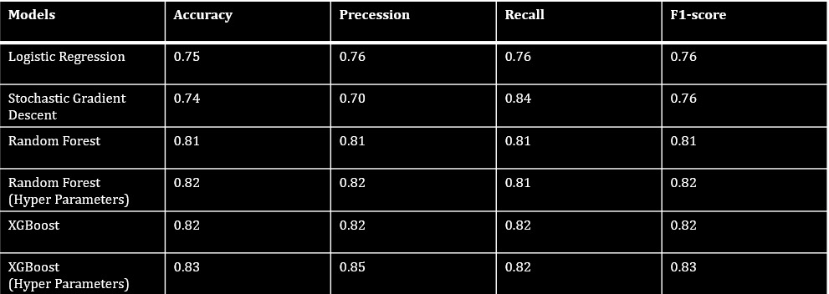
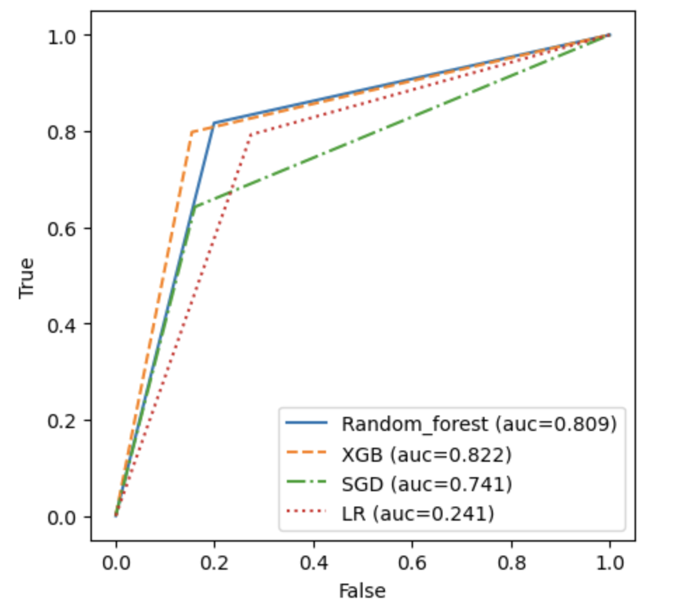
Performance Comparison (for customer)
Random Forest without resampling and KNN without resampling perform the best in terms of Accuracy, Precision, Recall, F1 Score and Kappa Score
Feature extraction using linear PCA & LDA do not fare well on the non-linear data, as they lead to drop in accuracy
SMOTE Upsampling drastically increases the computational time, and produces similar accuracy as those without any resampling
The effect of class imbalance, are however still reflected on all models without resampling, as seen in the ROC curves

Slide 17
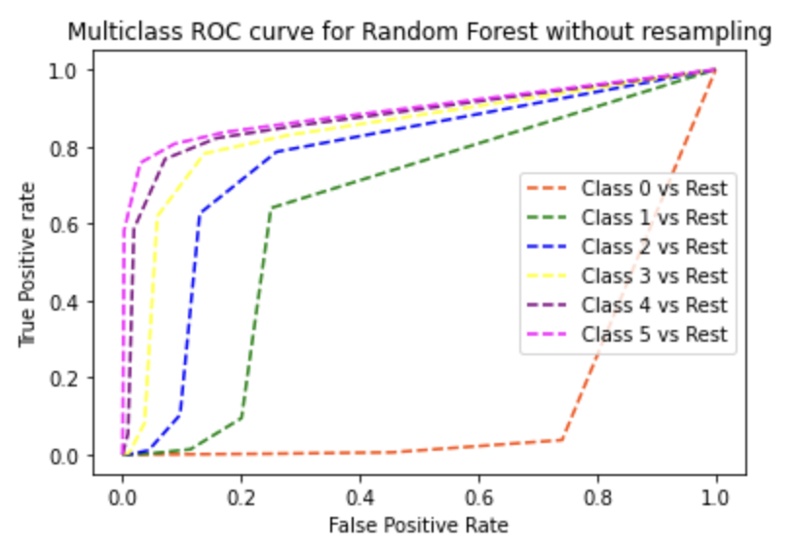
Performance Comparison (for overall sales)
Random Forest without resampling and KNN without resampling perform the best in terms of Accuracy, Precision, Recall, F1 Score and Kappa Score
Feature extraction using linear PCA & LDA do not fare well on the non-linear data, as they lead to drop in accuracy
SMOTE Upsampling drastically increases the computational time, and produces similar accuracy as those without any resampling
The effect of class imbalance, are however still reflected on all models without resampling, as seen in the ROC curves

Slide 18

Challenges and Future Work
Challenges
Data Volume –
Class Imbalance -
Non-Linearity –
Kernel Computations – Kernel methods such as Kernel PCA with any type of kernel required more computational resources than what is available in free versions of coding platforms
Hyperparameter Tuning – Had to settle for experimenting with limited parameter options due to time and resource complexity
Future Work
Experiment further with non-linear dimensionality reduction methods such as TSNE, Isomap, etc. for feature extraction
Creating a separate binary classifier for predicting whether the customer will make a purchase or not, and if yes, build a multi-class classifier to further predict the purchase history of the customer in order to achieve better accuracies for each class

Slide 19
Thank You!

Slide 20

References
https://www.kaggle.com/competitions/h-and-m-personalized-fashion-recommendations​
https://onlinelibrary.wiley.com/doi/abs/10.1002/9781119785873.ch3 ​
https://link-springer-com.libaccess.sjlibrary.org/chapter/10.1007/978-981-13-7721-1_27​
https://link-springer-com.libaccess.sjlibrary.org/chapter/10.1007/978-3-030-90321-3_5

